Slide 1
GRADE 1: EVS
ABOUT ME
PRESENTED BY
B.JEHANYA
PRIMARY CLT COORDINATOR

Slide 3
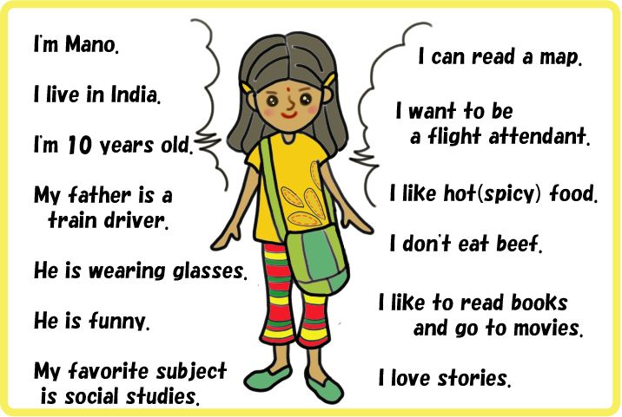
SELF INTRODUCTION

